Slide 1

ECE 3030 Physical Foundations of Computer Engineering MOS Electrostatics-I
Asif Khan
Department of Electrical and Computer Engineering
Georgia Institute of Technology
Notes:
Hello and welcome everyone.
It is my great pleasure giving this talk to such a distinguished audience.
My talk is about doing electronics with an advanced class of materials called ferroelectrics and complex oxides.
So let me first tell you what these materials are and why we want to use them.

Slide 2
Reference
Modern Semiconductor Devices for Integrated Circuits
Chapter 5: Section 5.3, 5.4, 5.5

Slide 3
Resources
Recorded lecture available at https://youtu.be/ZZuaSS0sfw8

Slide 4
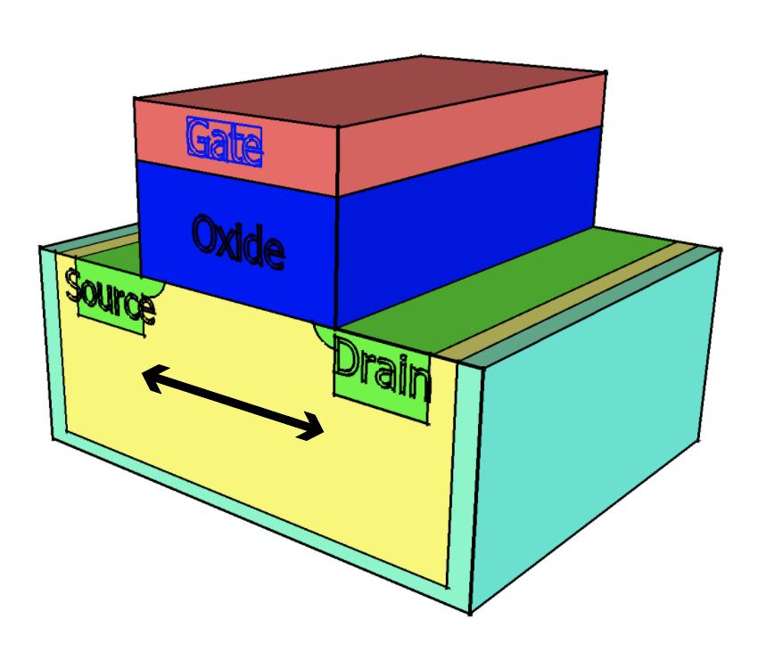
MOSFET

Slide 5
What happens when you apply gate voltage V_{G}?
Metal
Oxide
p-semiconductor
+
+
+
+
+
+
+
+
+
+
+
+
-
-
-
-
-
-
-
-
-
-
-
-
+
+
+
+
+
+
+
+
+
+
-
-
-
-
-
-
-
-
-
-
-
-
+
+
-
-
-
-
-
-
-
-
-
-
-
-
+
+
+
+
+
+
+
+
+
+
+
+
V_{G}=0 V
+
+
+
+
+
+
+
+
+
+
-
-
-
-
-
-
-
-
-
-
-
-
+
+
+
+
+
+
+
+
+
+
+
+
+
+
+
-
-
-
-
-
-
-
-
-
-
-
-
V_{G}
+
+
+
+
+
+
+
+
+
+
+
+
-
-
-
-
-
-
-
-
-
-
-
-
+
+
+
+
+
+
+
+
+
+
+
+
-
-
-
-
-
-
-
-
-
-
-
-
+
+
+
+
+
+
+
+
+
+
+
+
-
-
-
-
-
-
-
-
-
-
-
-

Slide 6
What happens when you apply gate voltage V_{G}?
Metal
Oxide
p-semiconductor
+
+
+
+
+
+
+
+
+
+
+
+
+
-
-
-
-
-
-
-
-
-
-
-
-
+
+
+
+
+
+
+
+
+
+
+
-
-
-
-
-
-
-
-
-
-
-
-
+
+
+
-
-
-
-
-
-
-
-
-
-
-
-
+
+
+
+
+
+
+
+
+
+
+
+
V_{G}=0.1 V
+
+
+
+
+
+
+
+
+
+
+
-
-
-
-
-
-
-
-
-
-
-
-
+
+
+
+
+
+
+
+
+
+
+
+
+
+
+
+
-
-
-
-
-
-
-
-
-
-
-
-
V_{G}
+
+
+
+
+
+
+
+
+
+
+
+
+
-
-
-
-
-
-
-
-
-
-
-
-
+
+
+
+
+
+
+
+
+
+
+
+
+
-
-
-
-
-
-
-
-
-
-
-
-
+
+
+
+
+
+
+
+
+
+
+
+
+
-
-
-
-
-
-
-
-
-
-
-
-
Depletion
W (Depletion width)

Slide 7
What happens when you apply gate voltage V_{G}?
Metal
Oxide
p-semiconductor
+
+
+
+
+
+
+
+
+
+
+
+
+
-
-
-
-
-
-
-
-
-
-
-
-
+
+
+
+
+
+
+
+
+
+
-
-
-
-
-
-
-
-
-
-
-
-
+
+
+
+
-
-
-
-
-
-
-
-
-
-
-
-
+
+
+
+
+
+
+
+
+
+
+
+
V_{G}=0.2 V
+
+
+
+
+
+
+
+
+
+
-
-
-
-
-
-
-
-
-
-
-
-
+
+
+
+
+
+
+
+
+
+
+
+
+
+
+
+
+
-
-
-
-
-
-
-
-
-
-
-
-
V_{G}
+
+
+
+
+
+
+
+
+
+
+
+
-
-
-
-
-
-
-
-
-
-
-
-
+
+
+
+
+
+
+
+
+
+
+
+
+
+
-
-
-
-
-
-
-
-
-
-
-
-
+
+
+
+
+
+
+
+
+
+
+
+
-
-
-
-
-
-
-
-
-
-
-
-
+
Depletion
W (Depletion width)

Slide 8
What happens when you apply gate voltage V_{G}?
Metal
Oxide
p-semiconductor
+
+
+
+
+
+
+
+
+
+
+
+
-
-
-
-
-
-
-
-
-
-
-
-
+
+
+
+
+
+
+
+
+
+
+
-
-
-
-
-
-
-
-
-
-
-
-
+
+
+
+
-
-
-
-
-
-
-
-
-
-
-
-
+
+
+
+
+
+
+
+
+
+
+
V_{G}=0.3 V
+
+
+
+
+
+
+
+
+
+
+
-
-
-
-
-
-
-
-
-
-
-
-
+
+
+
+
+
+
+
+
+
+
+
+
+
+
+
+
-
-
-
-
-
-
-
-
-
-
-
-
V_{G}
+
+
+
+
+
+
+
+
+
+
+
+
-
-
-
-
-
-
-
-
-
-
-
-
+
+
+
+
+
+
+
+
+
+
+
-
-
-
+
+
+
-
-
-
-
-
-
-
-
-
+
+
+
+
+
+
+
+
+
+
-
-
-
+
+
-
-
-
-
-
-
-
-
-
+
+
Depletion
W (Depletion width)

Slide 9
What happens when you apply gate voltage V_{G}?
Metal
Oxide
p-semiconductor
+
+
+
+
+
+
+
+
-
-
-
-
-
-
-
-
-
-
-
-
+
+
+
+
+
+
+
+
+
-
-
-
-
-
-
-
-
-
-
-
-
+
+
+
+
+
+
-
-
-
-
-
-
-
-
-
-
-
-
+
+
+
+
+
+
+
V_{G}=0.5 V
+
+
+
+
+
+
+
+
+
-
-
-
-
-
-
-
-
-
-
-
-
+
+
+
+
+
+
+
+
+
+
+
+
+
+
-
-
-
-
-
-
-
-
-
-
-
-
+
+
V_{G}
+
+
+
+
+
+
+
+
-
-
-
-
-
-
-
-
-
-
-
-
+
+
+
+
+
+
+
+
+
-
-
-
+
+
+
-
-
-
-
-
-
-
-
-
+
+
+
+
+
+
+
+
+
-
-
-
+
+
-
-
-
-
-
-
-
-
-
+
+
+
Depletion
W (Depletion width)

Slide 10
What happens when you apply V_{G}>Threshold?
Metal
Oxide
p-semiconductor
+
-
+
+
+
+
+
+
+
-
-
-
-
-
-
-
-
-
-
-
-
+
+
+
-
+
+
+
+
+
-
-
-
-
-
-
-
-
-
-
-
-
+
+
+
+
+
+
-
+
-
-
-
-
-
-
-
-
-
-
-
-
+
+
+
+
+
+
+
V_{G}=0.6 V
+
-
+
+
+
+
+
+
+
-
-
-
-
-
-
-
-
-
-
-
-
+
+
+
+
+
+
-
+
+
+
+
+
+
+
+
-
-
-
-
-
-
-
-
-
-
-
-
+
+
+
V_{G}
+
-
+
+
+
+
+
+
-
-
-
-
-
-
-
-
-
-
-
-
+
+
+
-
+
+
+
+
+
+
-
-
-
+
+
+
-
-
-
-
-
-
-
-
-
+
+
+
+
-
+
+
+
+
+
-
-
-
+
+
-
-
-
-
-
-
-
-
-
+
+
+
+
Electrons
Carrier inversion
W (Depletion width)

Slide 11
What happens when you apply V_{G}>Threshold?
Metal
Oxide
p-semiconductor
+
-
+
-
+
+
+
+
+
+
-
-
-
-
-
-
-
-
-
-
-
-
+
+
+
-
+
+
-
+
+
+
+
-
-
-
-
-
-
-
-
-
-
-
-
+
+
+
+
+
+
-
+
+
-
-
-
-
-
-
-
-
-
-
-
-
-
+
+
+
+
+
+
+
V_{G}=0.8 V
+
-
+
+
+
-
+
+
+
+
+
-
-
-
-
-
-
-
-
-
-
-
-
+
+
+
+
+
+
-
+
+
-
+
+
+
+
+
+
+
-
-
-
-
-
-
-
-
-
-
-
-
+
+
+
V_{G}
+
-
+
+
+
+
+
+
+
-
-
-
-
-
-
-
-
-
-
-
-
-
+
+
+
-
+
+
+
+
+
+
+
-
-
-
-
+
+
+
-
-
-
-
-
-
-
-
-
+
+
+
+
-
+
+
+
+
+
+
-
-
-
+
+
-
-
-
-
-
-
-
-
-
-
+
+
+
+
+
Electrons
Carrier inversion
W (Depletion width)

Slide 12
What happens when you apply V_{G}>Threshold?
Metal
Oxide
p-semiconductor
+
-
+
-
+
+
+
+
+
+
-
-
-
-
-
-
-
-
-
-
-
-
-
+
-
+
-
+
+
-
+
+
+
-
+
+
+
+
-
-
-
-
-
-
-
-
-
-
-
-
+
+
+
-
+
-
+
-
+
+
-
+
+
+
-
-
-
-
-
-
-
-
-
-
-
-
-
+
+
-
+
+
+
+
+
+
-
V_{G}=0.8 V
+
-
+
-
+
+
+
-
+
+
+
+
+
-
-
-
-
-
-
-
-
-
-
-
-
+
+
+
-
+
-
+
-
+
+
-
+
+
+
-
+
+
+
+
+
+
-
-
-
-
-
-
-
-
-
-
-
-
+
+
-
+
-
+
-
+
V_{G}
+
-
+
+
+
+
+
+
+
+
-
-
-
-
-
-
-
-
-
-
-
-
-
+
+
-
+
-
+
-
+
-
+
+
+
+
+
+
+
-
-
-
-
+
+
+
-
-
-
-
-
-
-
-
-
+
-
+
-
+
-
+
+
-
+
+
+
+
+
+
+
-
-
-
+
+
-
-
-
-
-
-
-
-
-
-
+
-
+
-
+
-
+
+
+
+
Electrons
Carrier inversion
W (Depletion width)

Slide 13
How to create inversion?
n-type
p-type
E_{c}
E_{c}
E_{F}
E_{i}
E_{i}
E_{F}
E_{v}
E_{v}
The closer the Fermi level is to the conduction band, the larger is the number of electrons
The closer the Fermi level is to the valence band, the larger is the number of holes

Slide 14
How to create inversion?
E_{c}
E_{i}
E_{F}
E_{v}

Slide 15
How to create inversion?
Before
At Threshold
E_{c}
2ψ_{B}
E_{i}
E_{c}
qψ_{B}
E_{F}
qψ_{B}
E_{v}
E_{i}
The semiconductor needs to a voltage/electrostatic potential=2qψ_{B} for carrier inversion
E_{v}

Slide 16
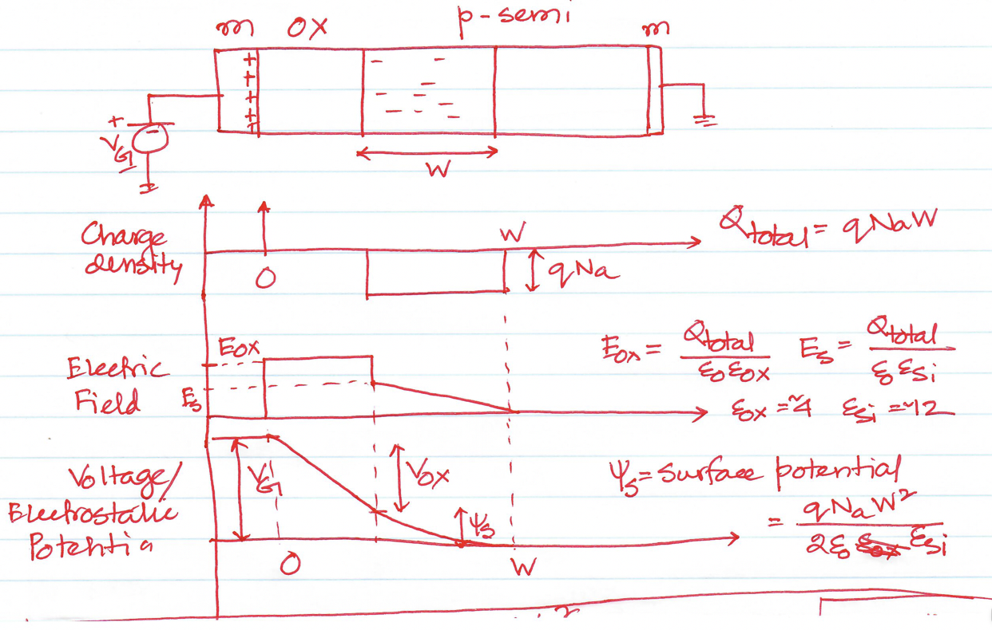
Electrostatics of MOS Capacitors

Slide 17
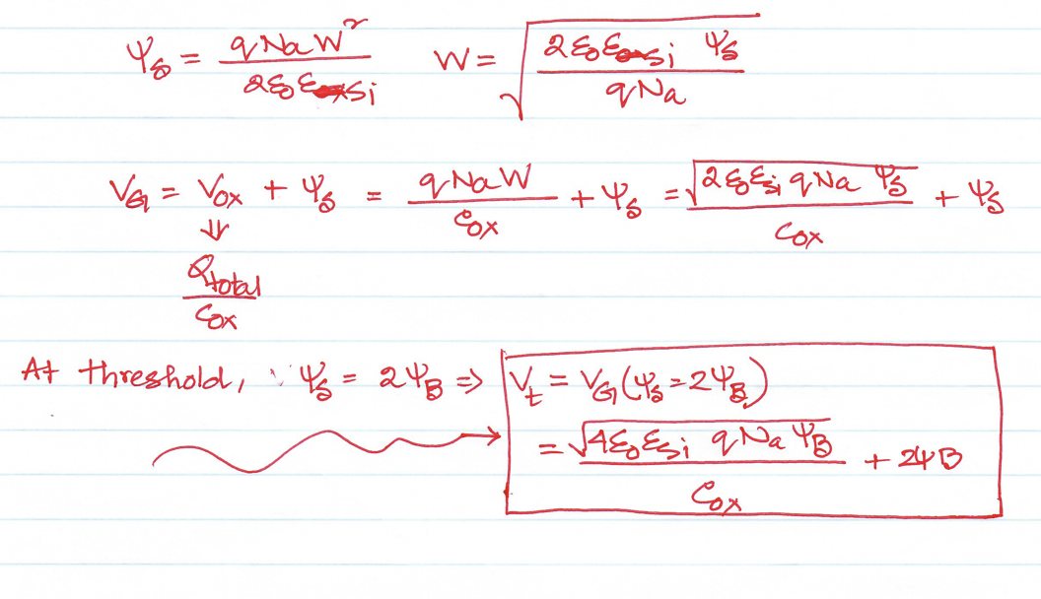
Electrostatics of MOS Capacitors

Slide 18
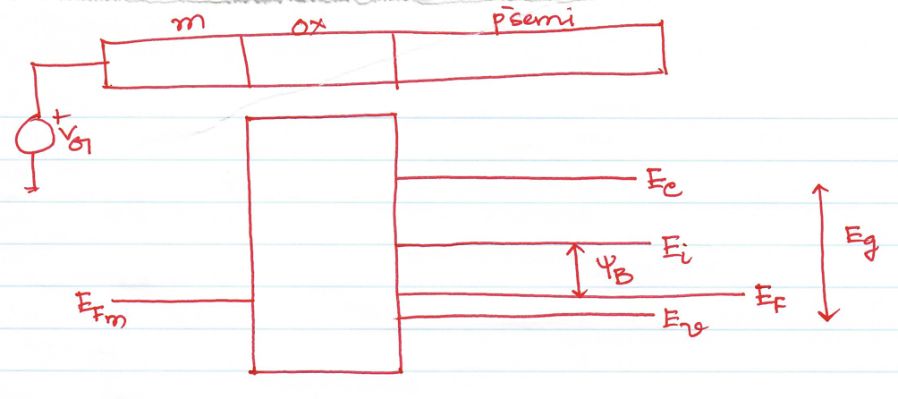
Band Diagram with VG=0

Slide 19
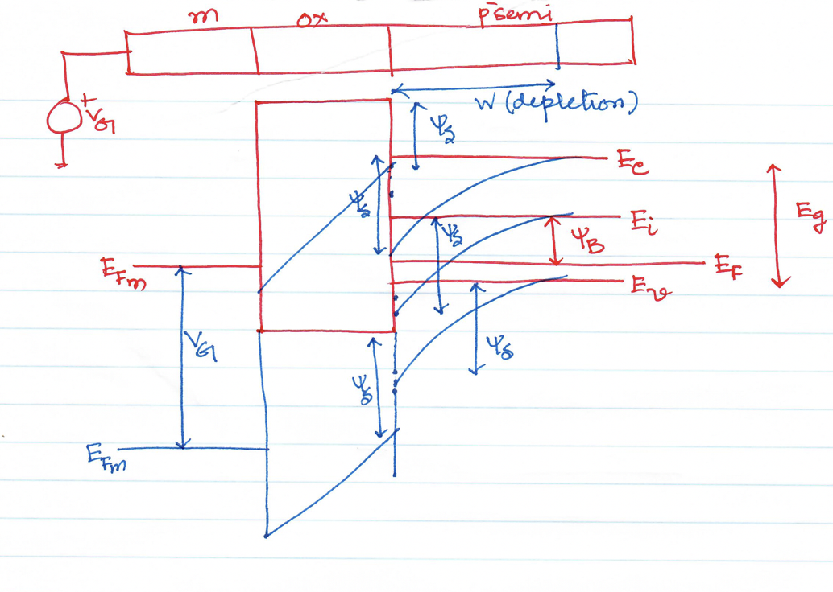
Band Diagram with an applied VG

Slide 20
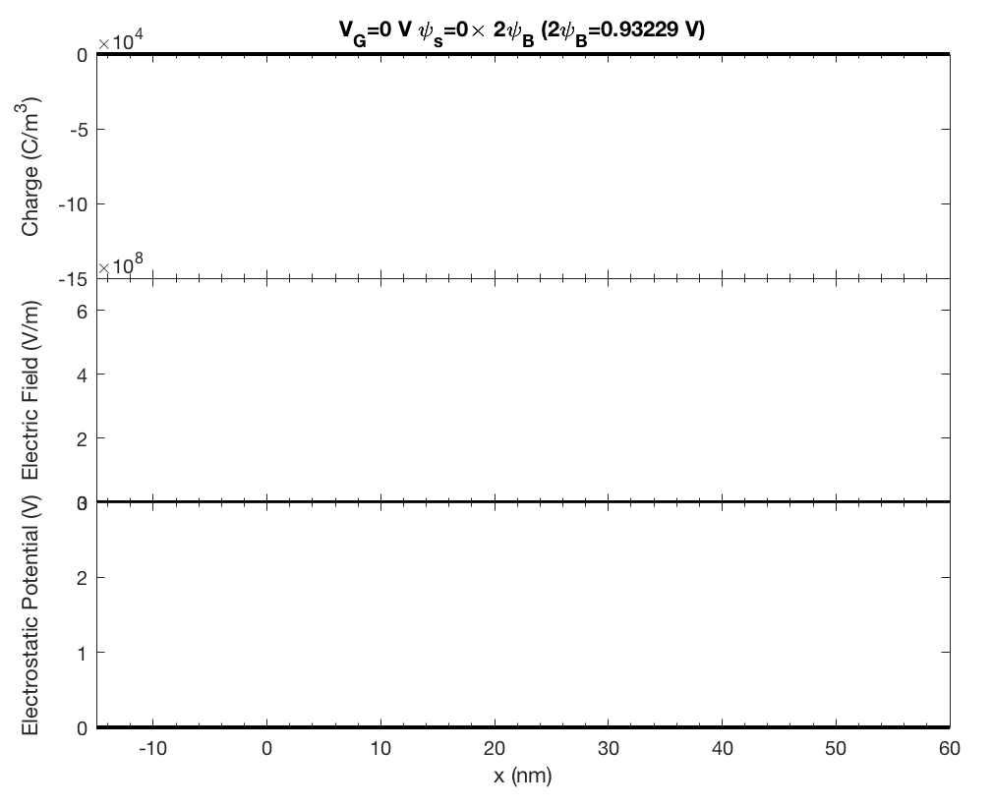
metal
ox
p-semi
+
V_{G}
N_{A}=1e24 /m³

Slide 21
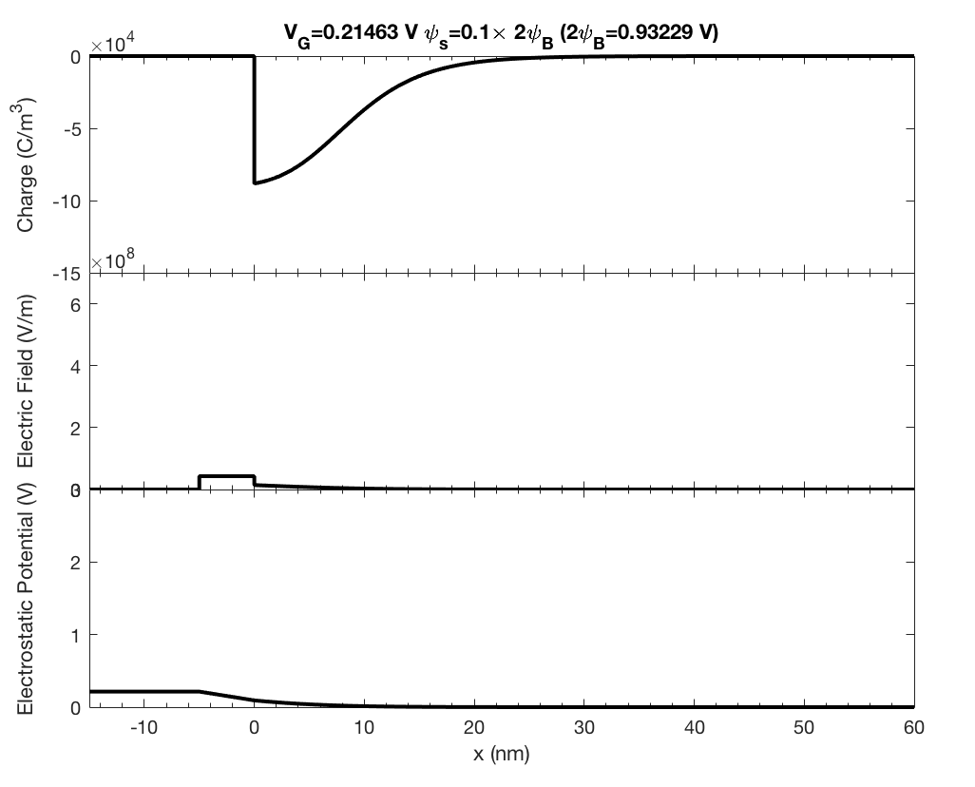
metal
ox
p-semi
+
V_{G}
N_{A}=1e24 /m³

Slide 22
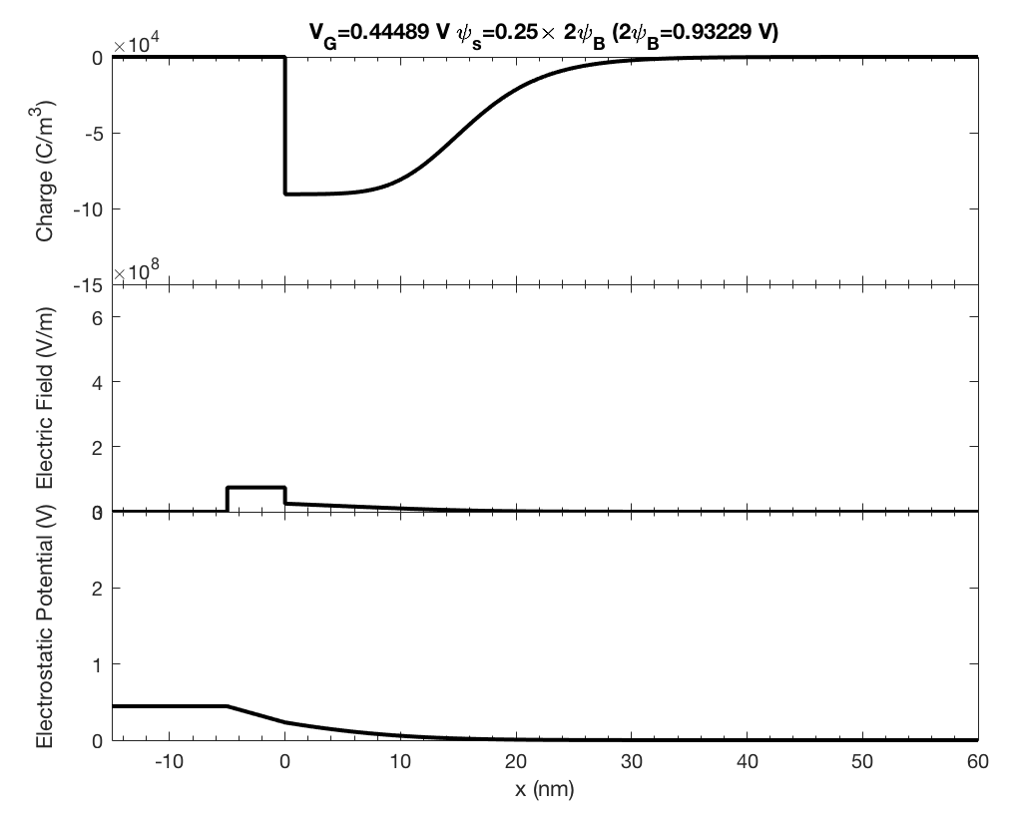
metal
ox
p-semi
+
V_{G}
N_{A}=1e24 /m³

Slide 23
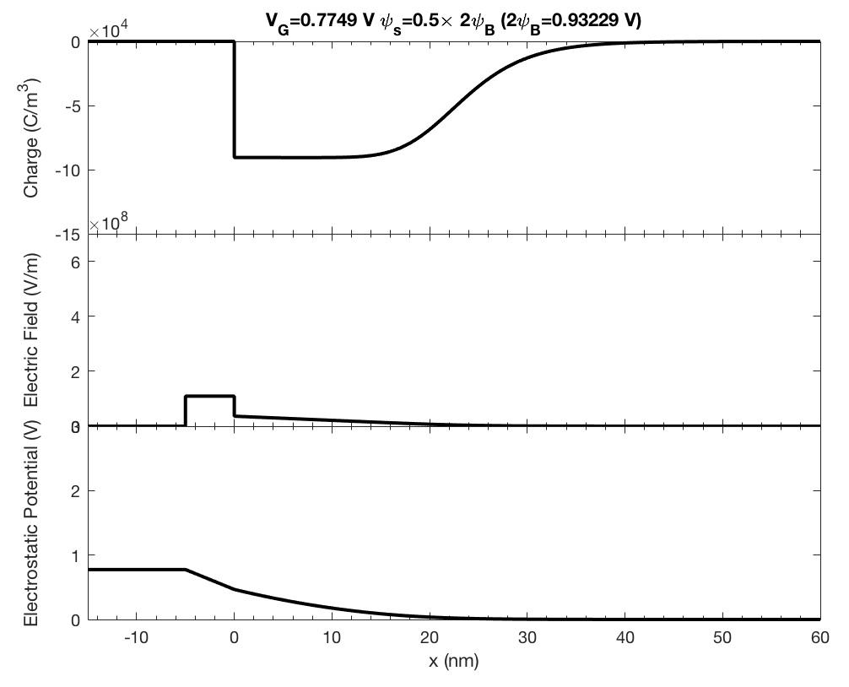
metal
ox
p-semi
+
V_{G}
N_{A}=1e24 /m³

Slide 24
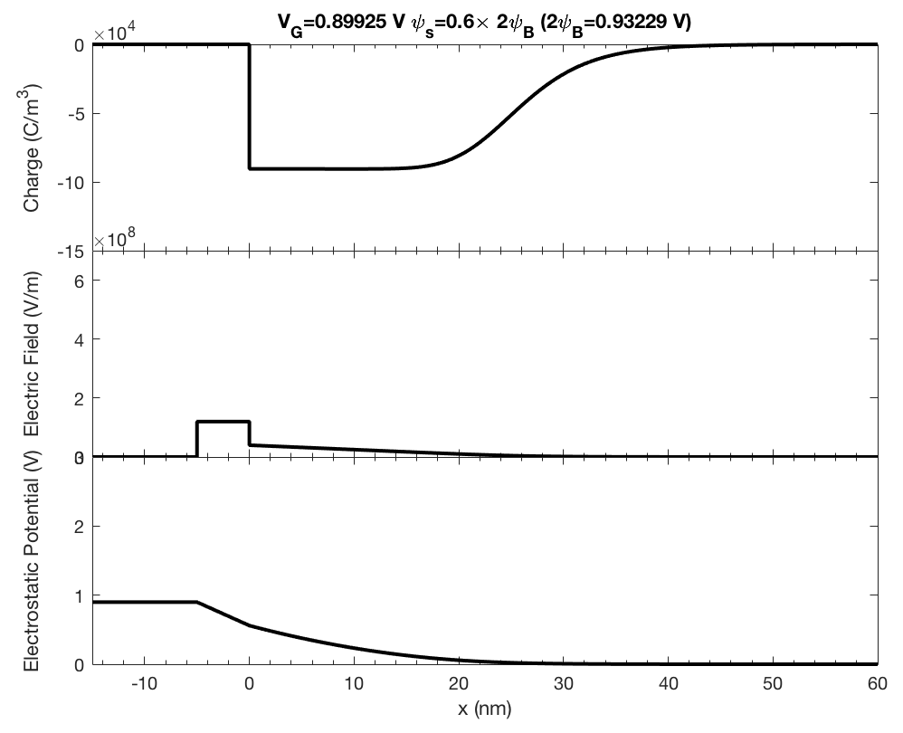
metal
ox
p-semi
+
V_{G}
N_{A}=1e24 /m³

Slide 25
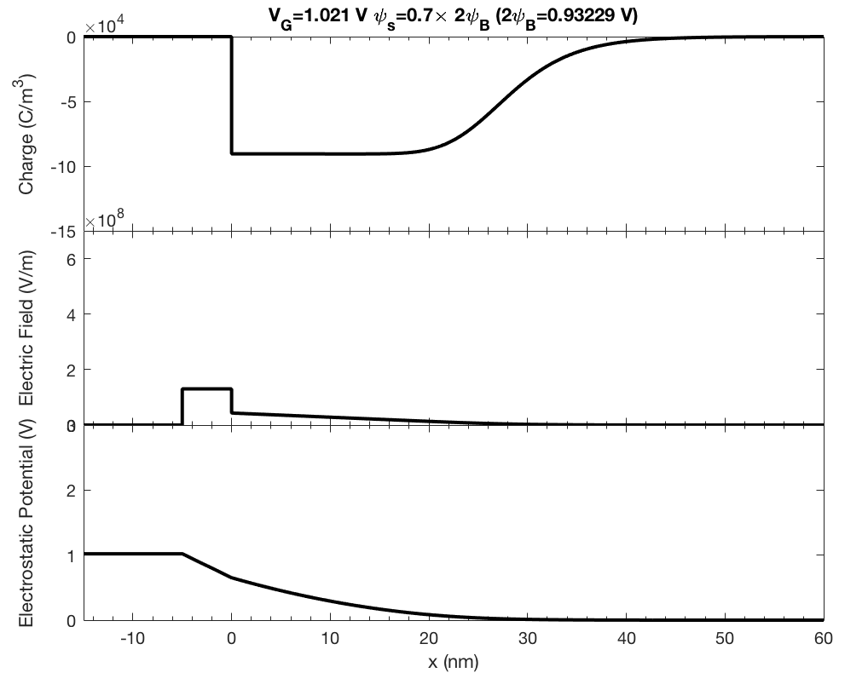
metal
ox
p-semi
+
V_{G}
N_{A}=1e24 /m³

Slide 26
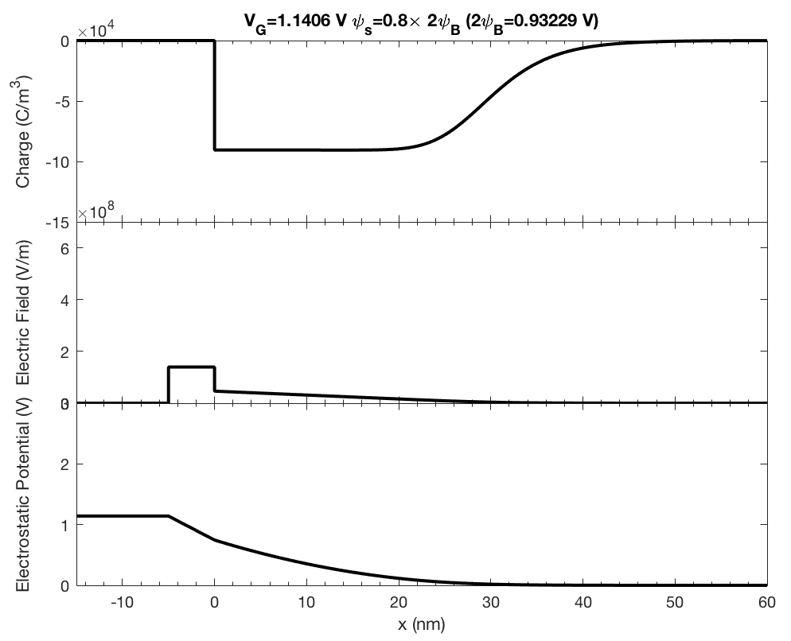
metal
ox
p-semi
+
V_{G}
N_{A}=1e24 /m³

Slide 27
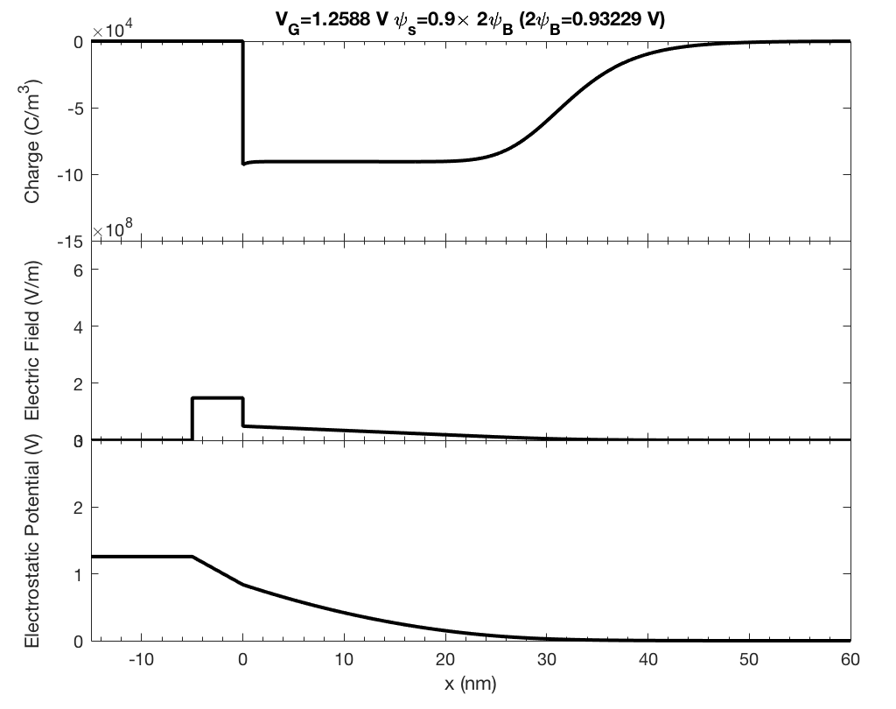
metal
ox
p-semi
+
V_{G}
N_{A}=1e24 /m³

Slide 28
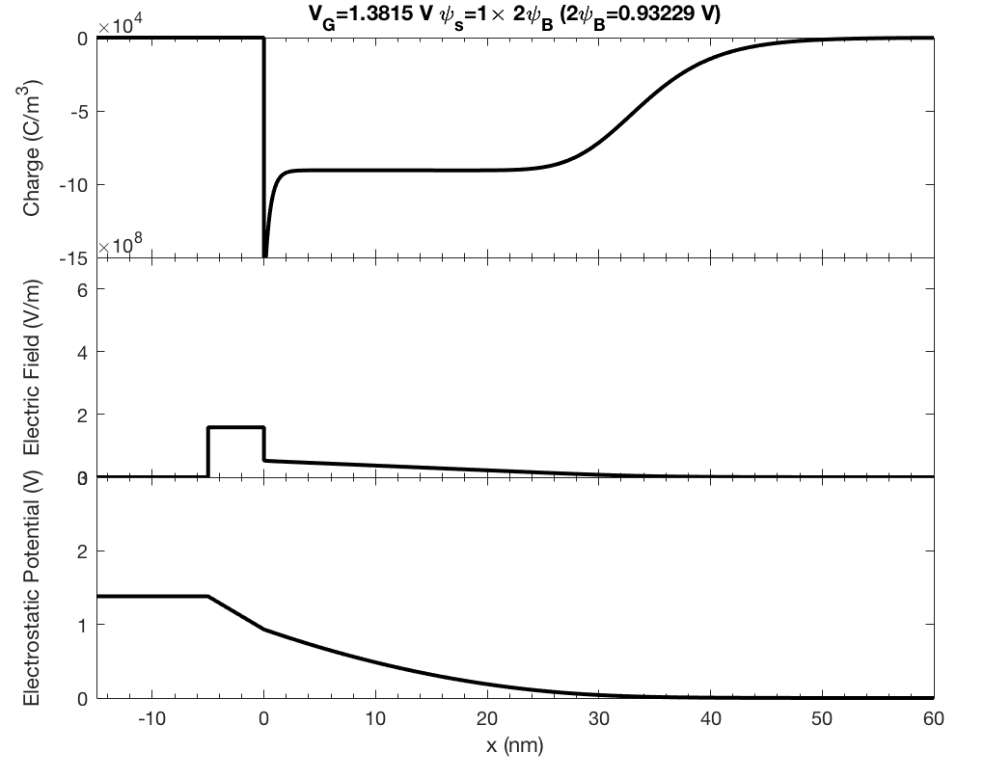
metal
ox
p-semi
+
V_{G}
N_{A}=1e24 /m³

Slide 29
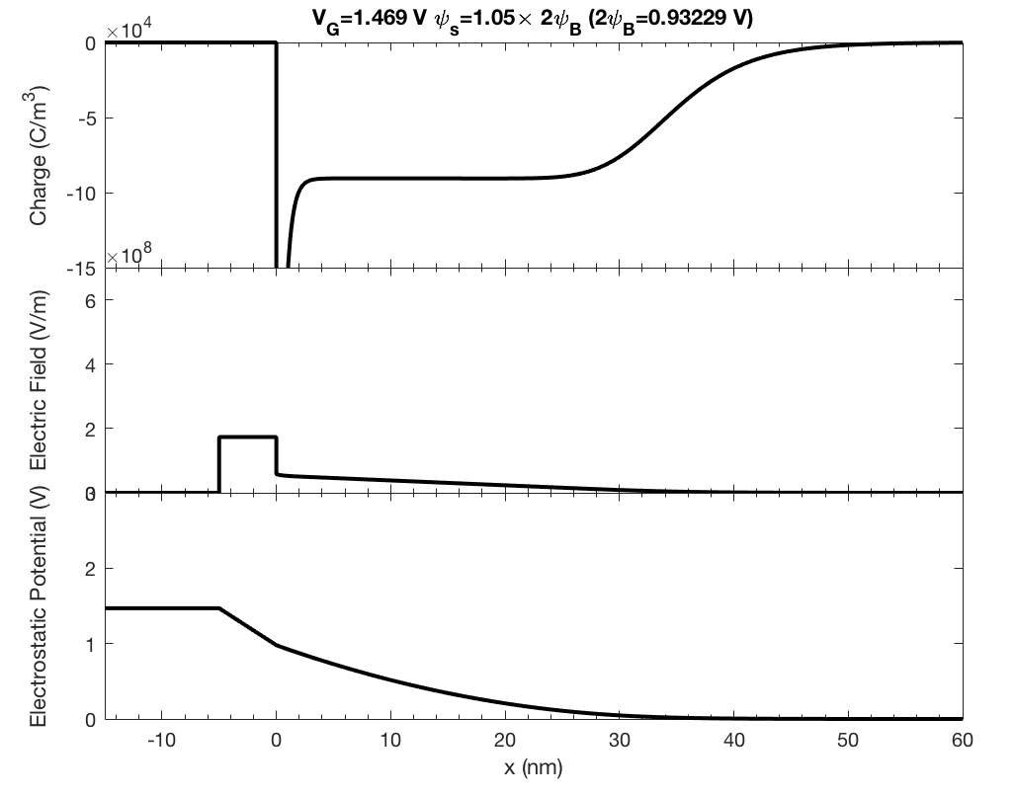
metal
ox
p-semi
+
V_{G}
N_{A}=1e24 /m³

Slide 30
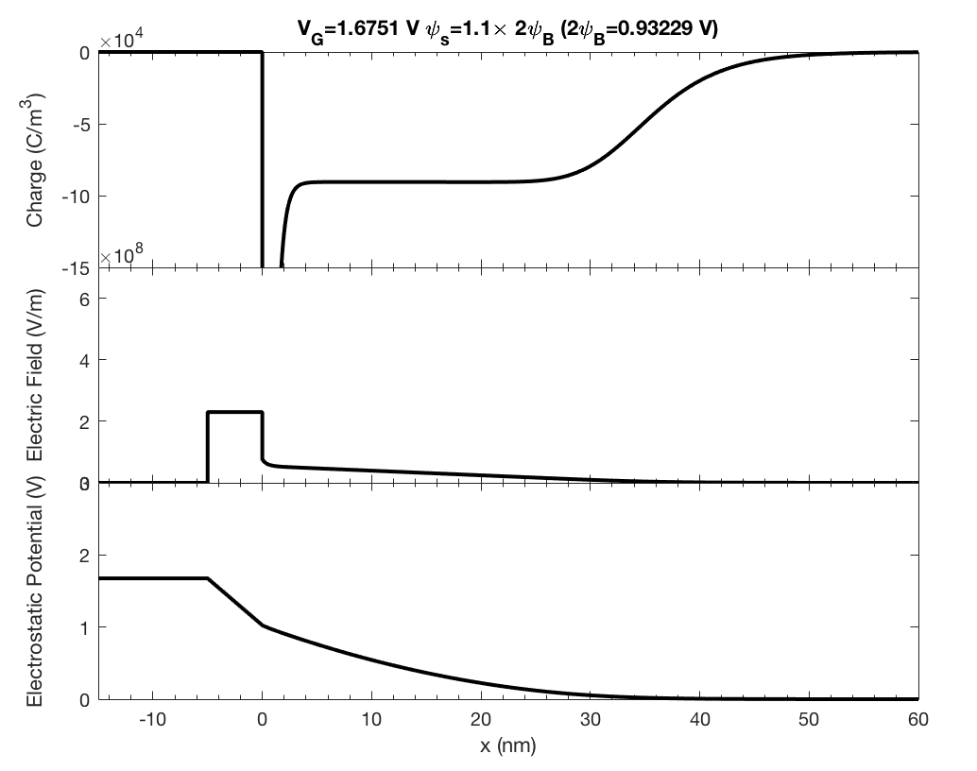
metal
ox
p-semi
+
V_{G}
N_{A}=1e24 /m³

Slide 31
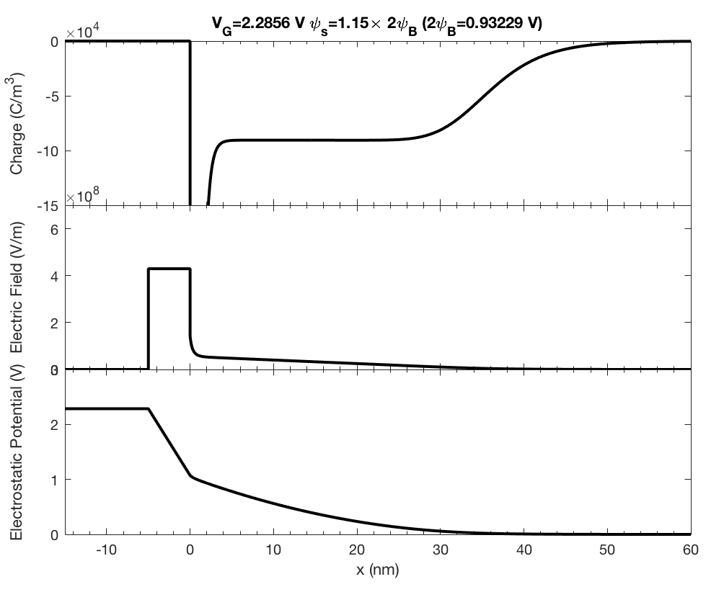
metal
ox
p-semi
+
V_{G}
N_{A}=1e24 /m³

Slide 32
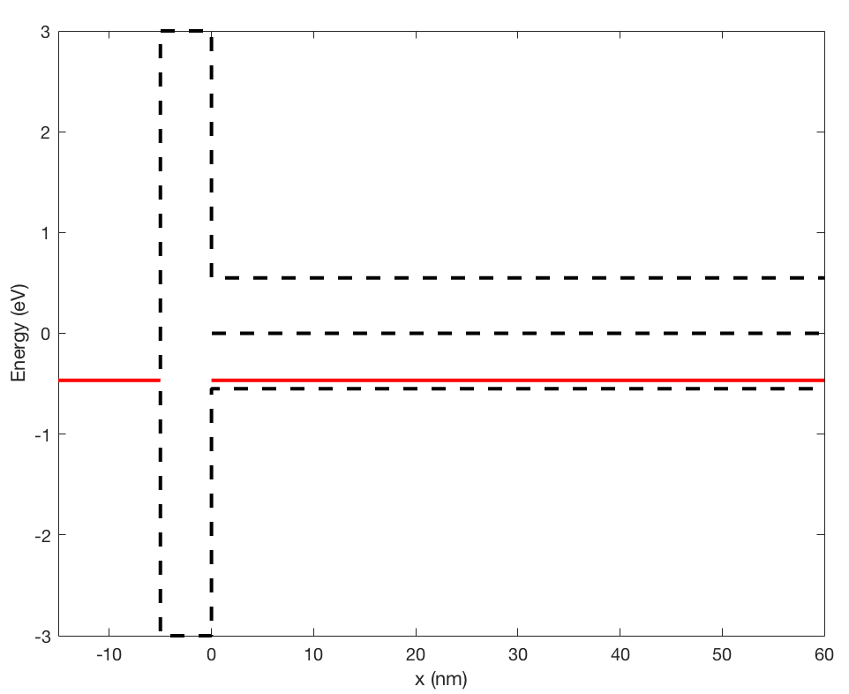
Band Diagram of MOS Capacitors
metal
ox
p-semi
+
V_{G}
E_{c}
E_{i}
E_{F}
E_{F(metal)}
E_{v}
V_{G}=0
N_{A}=1e24 /m³

Slide 33
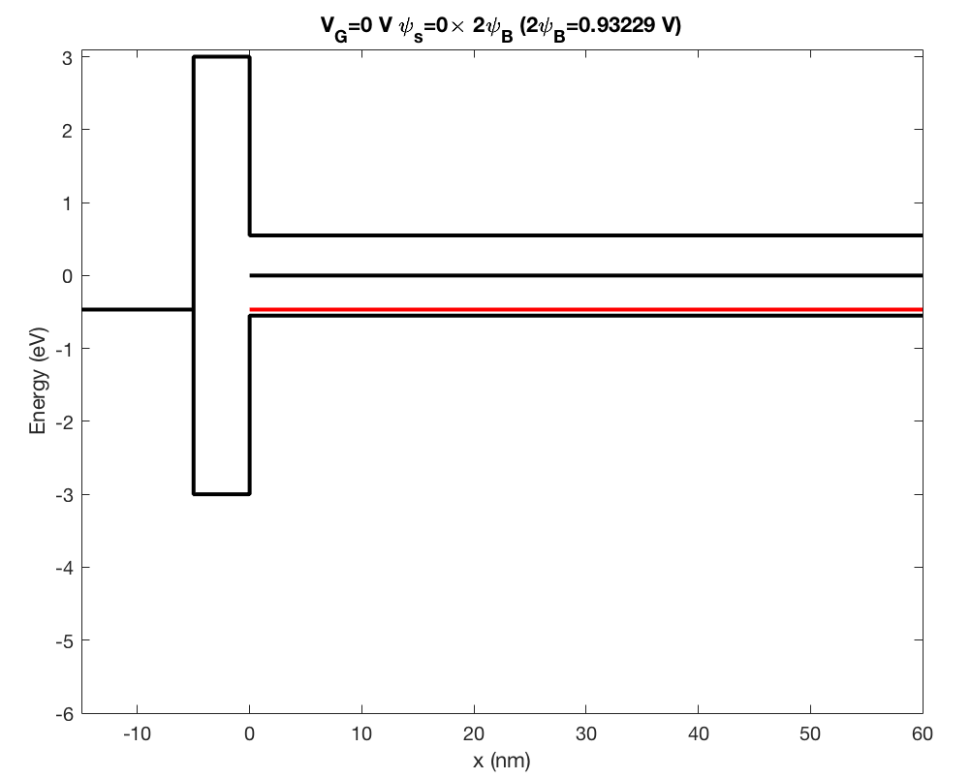
metal
ox
p-semi
+
V_{G}
N_{A}=1e24 /m³

Slide 34
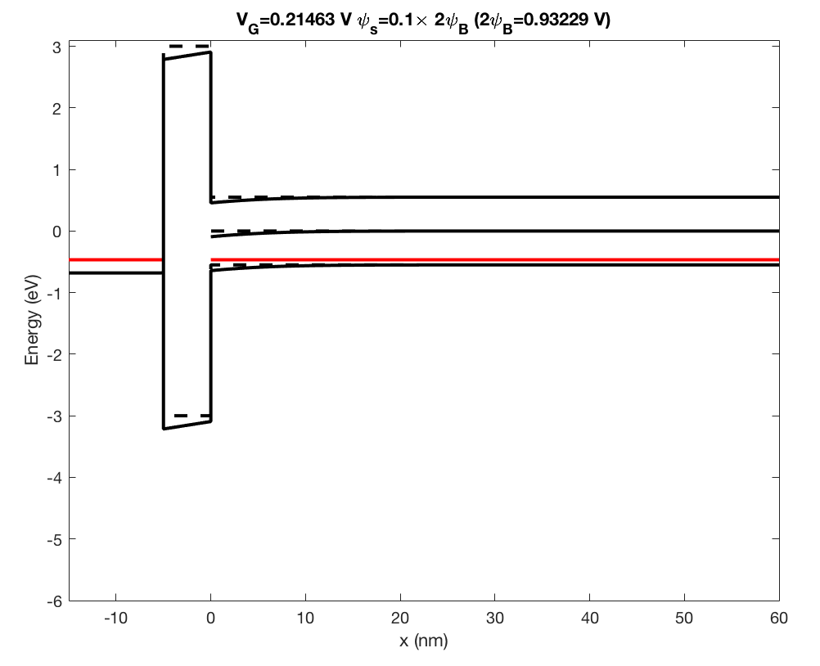
metal
ox
p-semi
+
V_{G}
N_{A}=1e24 /m³

Slide 35
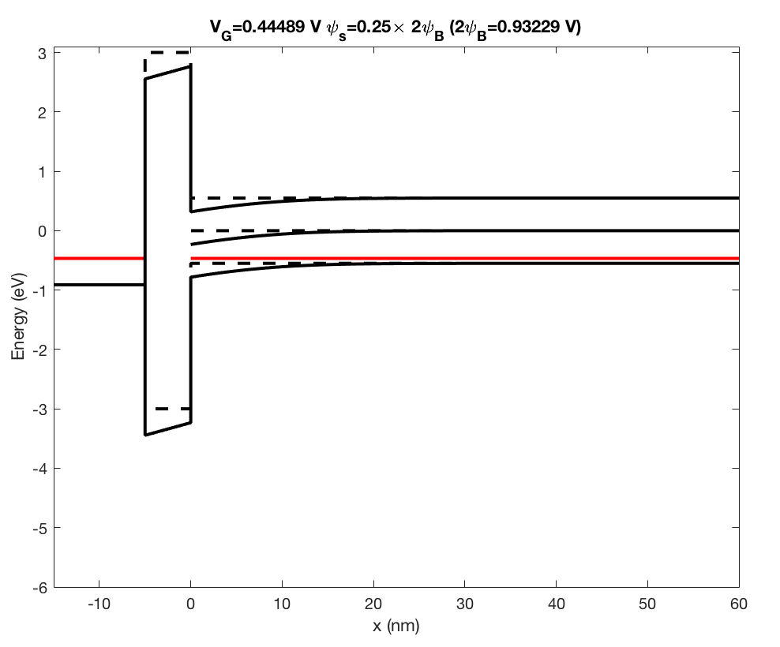
metal
ox
p-semi
+
V_{G}
N_{A}=1e24 /m³

Slide 36
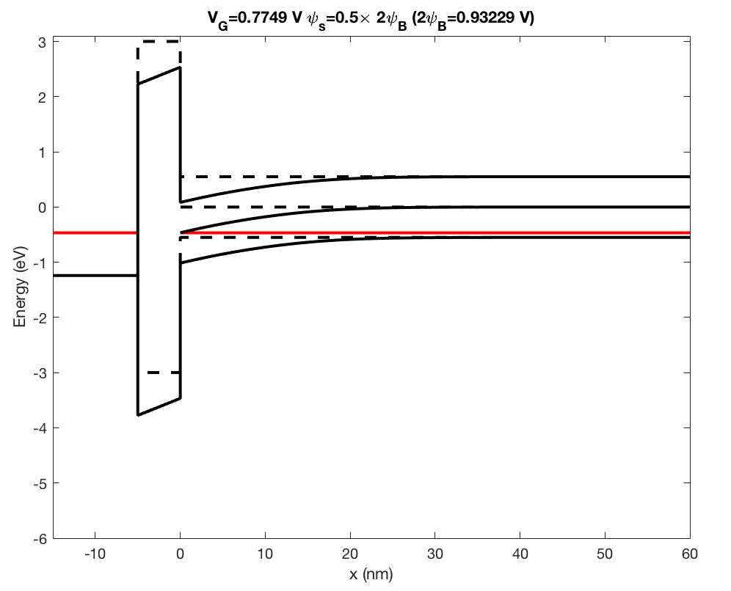
metal
ox
p-semi
+
V_{G}
N_{A}=1e24 /m³

Slide 37
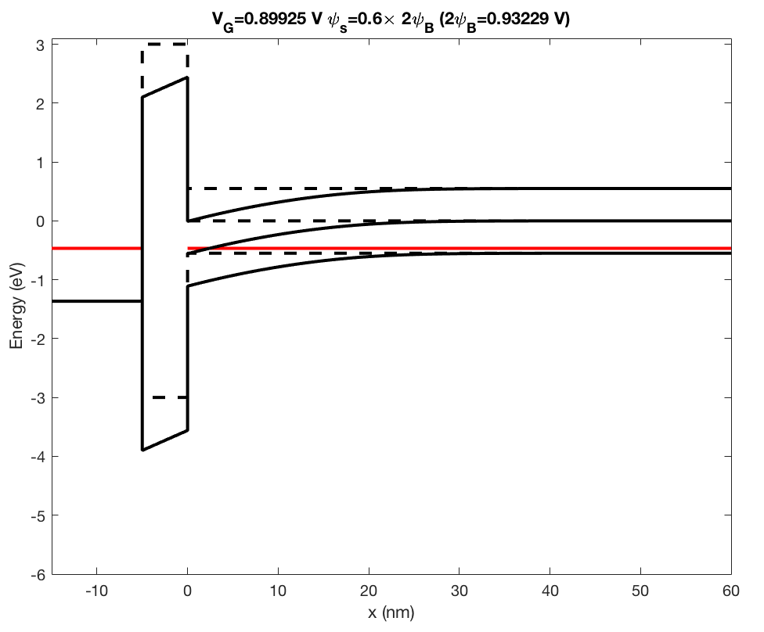
metal
ox
p-semi
+
V_{G}
N_{A}=1e24 /m³

Slide 38
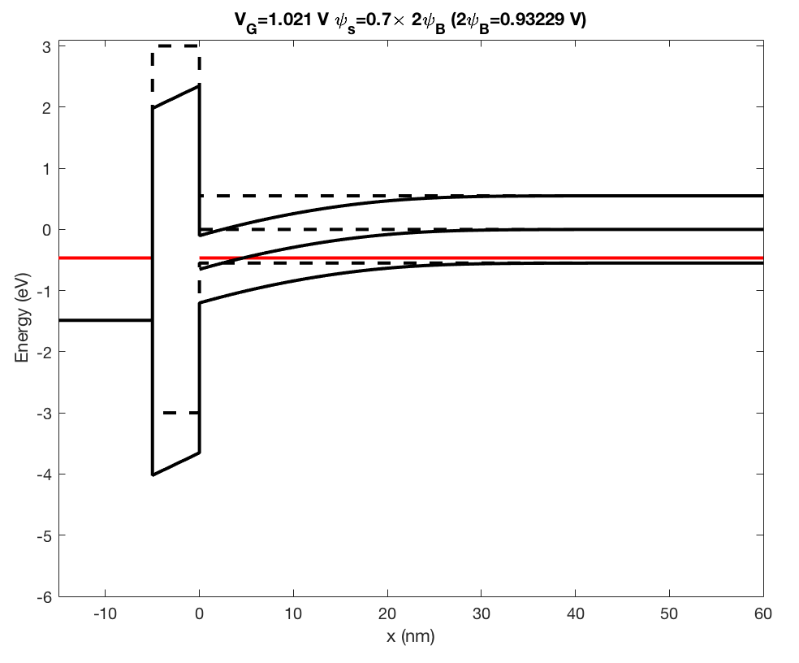
metal
ox
p-semi
+
V_{G}
N_{A}=1e24 /m³

Slide 39
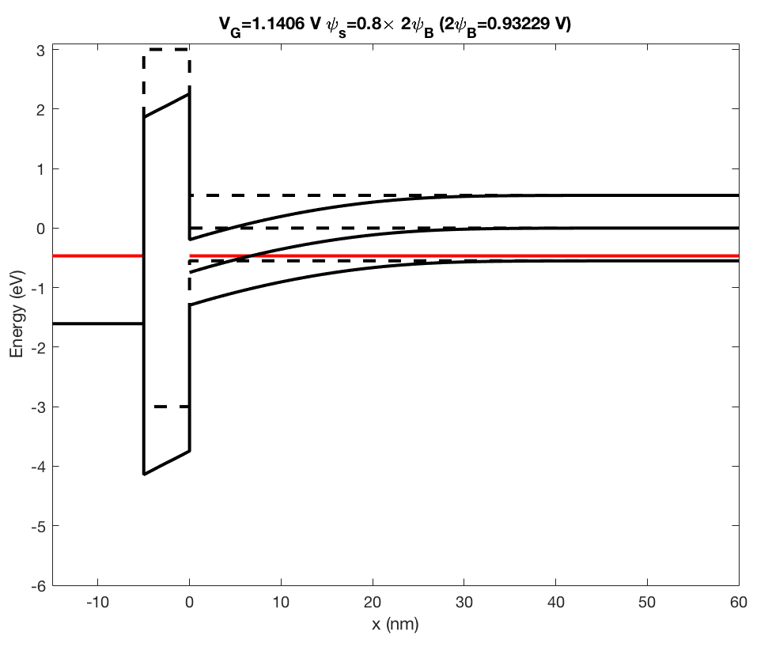
metal
ox
p-semi
+
V_{G}
N_{A}=1e24 /m³

Slide 40
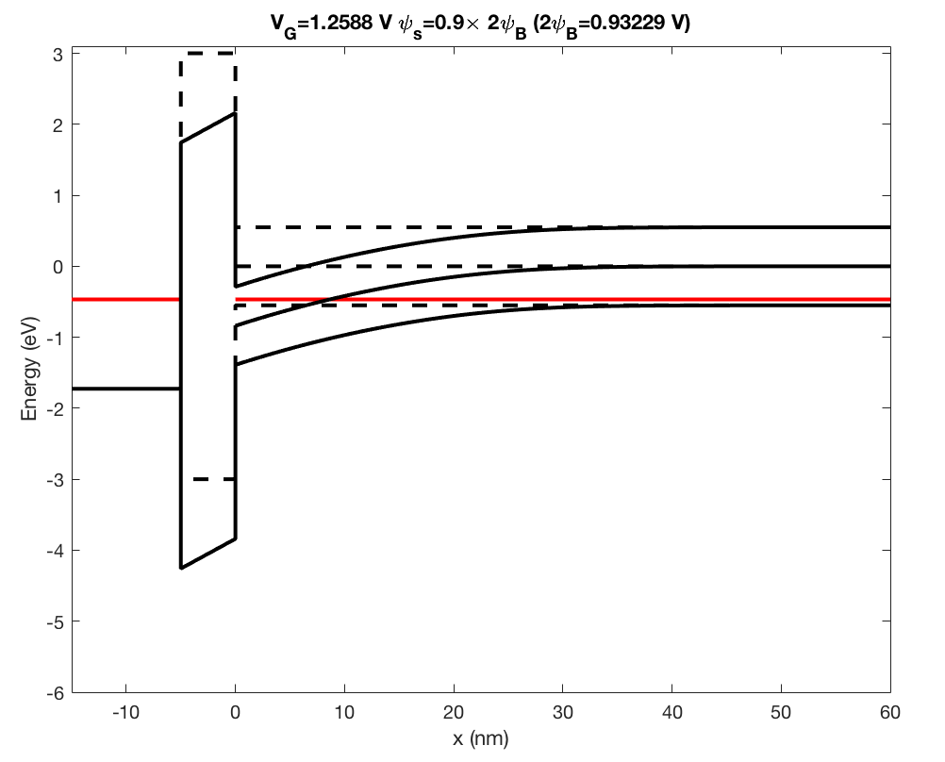
metal
ox
p-semi
+
V_{G}
N_{A}=1e24 /m³

Slide 41
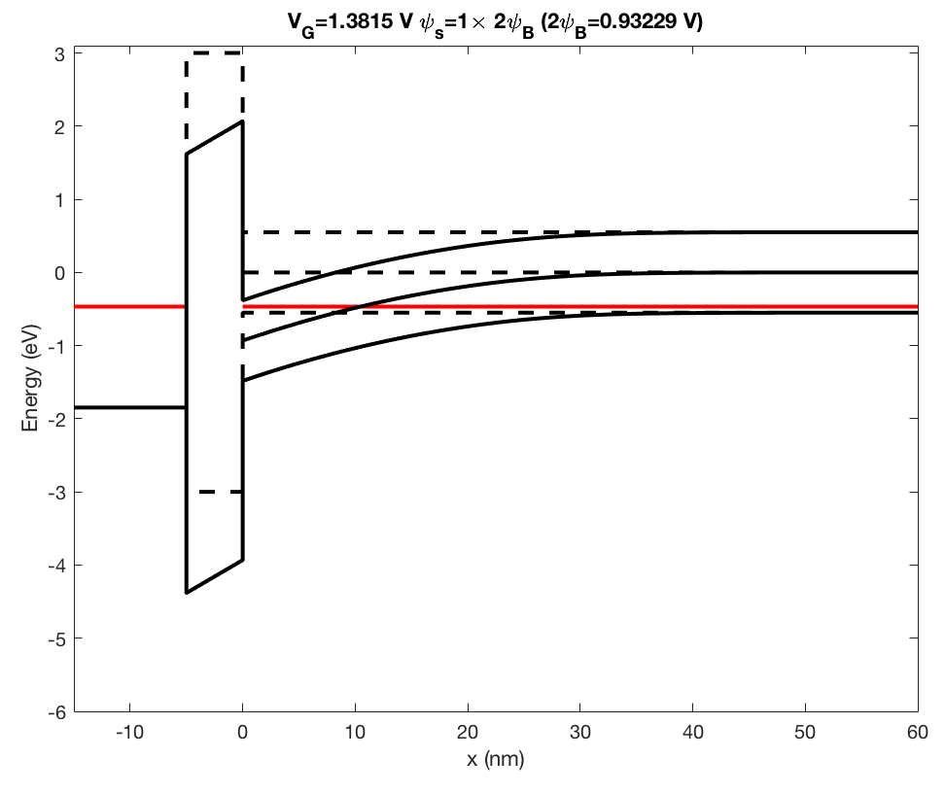
metal
ox
p-semi
+
V_{G}
N_{A}=1e24 /m³

Slide 42
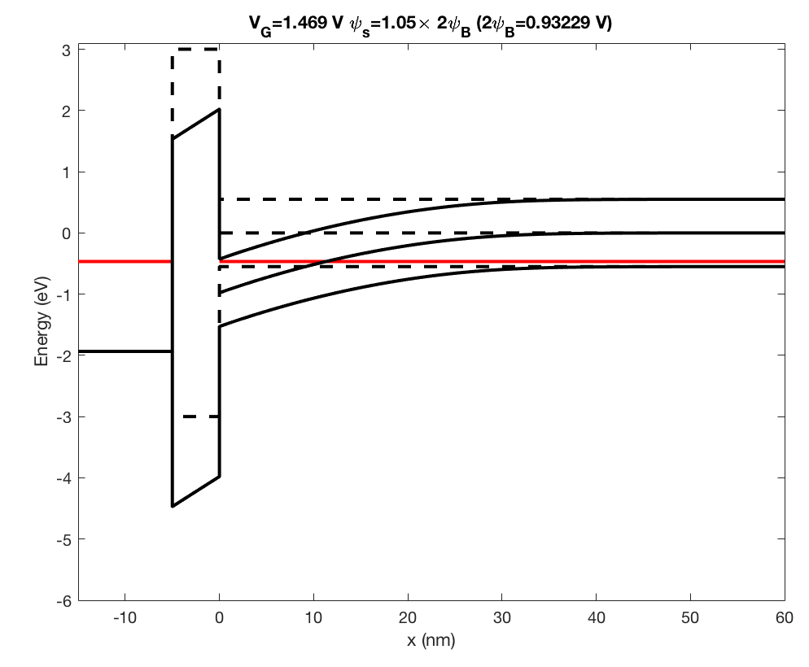
metal
ox
p-semi
+
V_{G}
N_{A}=1e24 /m³

Slide 43
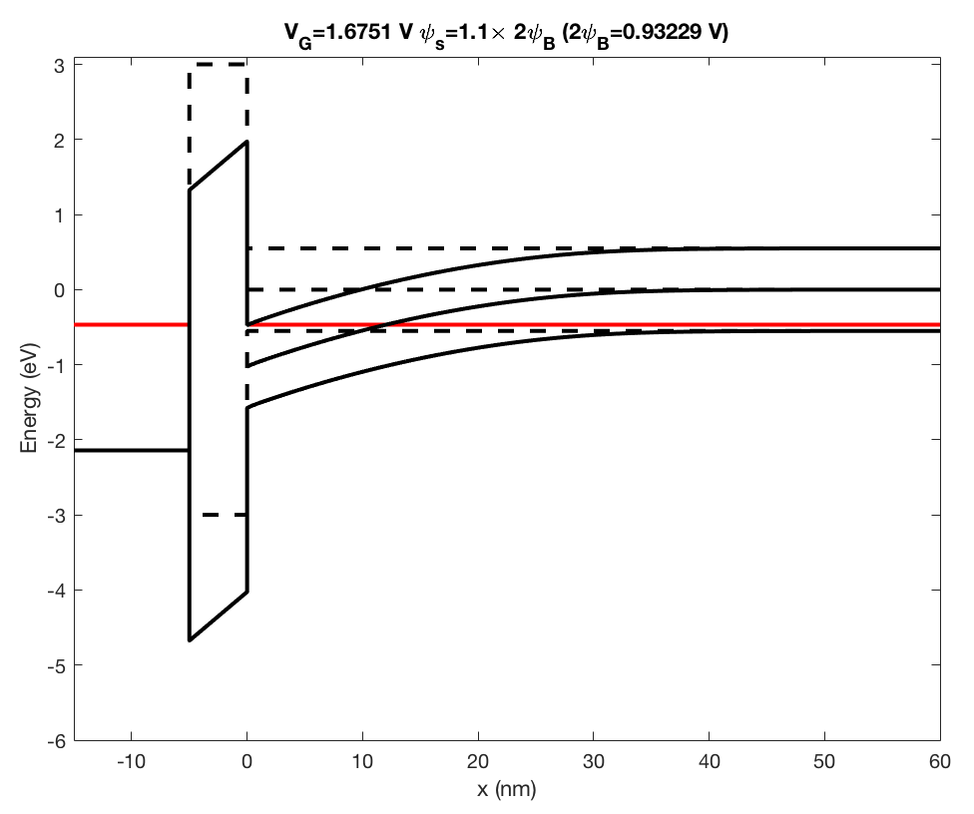
metal
ox
p-semi
+
V_{G}
N_{A}=1e24 /m³

Slide 44
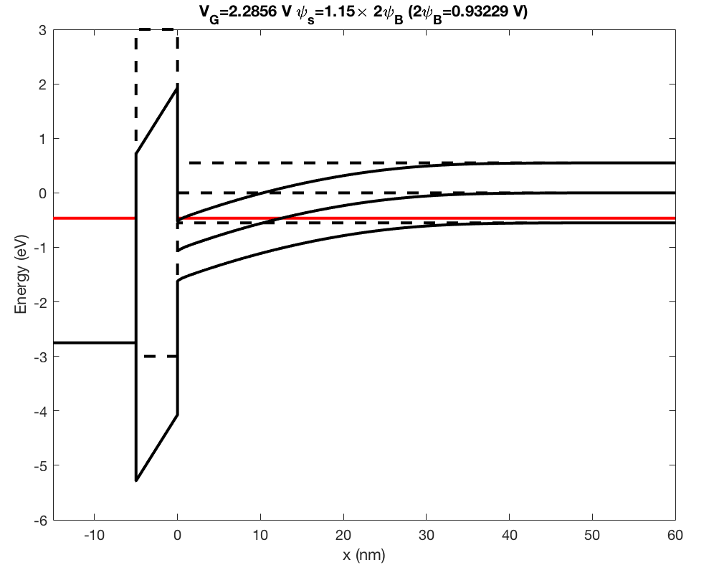
metal
ox
p-semi
+
V_{G}
N_{A}=1e24 /m³

